Slide 1
ΕΡΓΑΣΙΑ “FANS AND NBA TEAMS”
ΔΙΑΔΙΚΤΥο ΚΑΙ ΕΦΑΡΜΟΓΕΣ
"Τεχνο-Οικονομικά Συστήματα"
ΔΑΜΙΑΝΟΣ ΚΑΛΑΝΙΔΗΣ

Slide 2
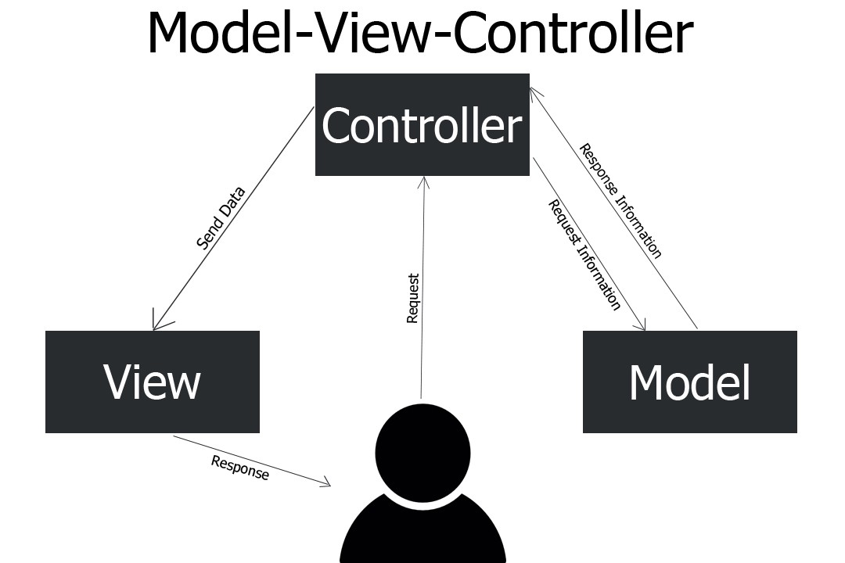
MVC Architecture(Model View Controller)

Slide 3
Dataflow
MVC Architecture(Model View Controller)
Client
NBA API
RapidAPI
View Layer
View (JSP Pages)
View (JSP Pages)
View (JSP Pages)
View (JSP Pages)
MainController
Spring Controller
NbateamController
UserController
UserandteamController
NbateamCrudController
UserCrudController
Service Layer
NbateamServiceImplementation
NbateamServiceInterface
UserServiceImplementation
UserServiceInterface
UserandteamServiceImplementation
UserandteamServiceInterface
NbateamServiceCrud
UserRepositoryCrud
Data Access Layer
NbateamDaoImplementation
NbateamDao
UserDaoImplementation
UserDao
UserandteamDaoImplementation
UserandteamDao
NbateamRepositoryCrud
UserRepositoryCrud
Database

Slide 4
MVC Architecture(Model View Controller)
View
Views
home.jsp
listteam.jsp
listteams.jsp
listuser.jsp
listusers.jsp
listusersandteams.jsp
newuserform.jsp
userform.jsp
Controller
Controllers
MainController.java
NbateamController.java
NbateamCrudController.java
UserController.java
UserCrudController.java
UserandteamController.java
Model
Service Layer
NbateamServiceCrud.java
NbateamServiceImplementation.java
NbateamServiceInterface.java
UserandteamServiceImplementation.java
UserandteamServiceInterface.java
UserServiceCrud.java
UserServiceImplementation.java
UserServiceInterface.java
Repositories
NbateamRepository.java
UserRepository.java
Data Access Layer (DAOs)
NbateamDao.java
NbateamDaoImplementation.java
UserDao.java
UserDaoImplementation.java
UserandteamDao.java
UserandteamDaoImplementation.java
Entities
Nbateam.java
User.java
Userdetails.java

Slide 5
MySQL Database
Table: User
Columns
id
email
first_name
city
nbateamid
Table: Nbateam
Columns
Id
abbreviation
city
conference
division
fullname
name

